Slide 1
Understanding Entropy in Bulls and Cows
Theoretical Background, Gameplay Insights, and Practical Implications

Slide 2
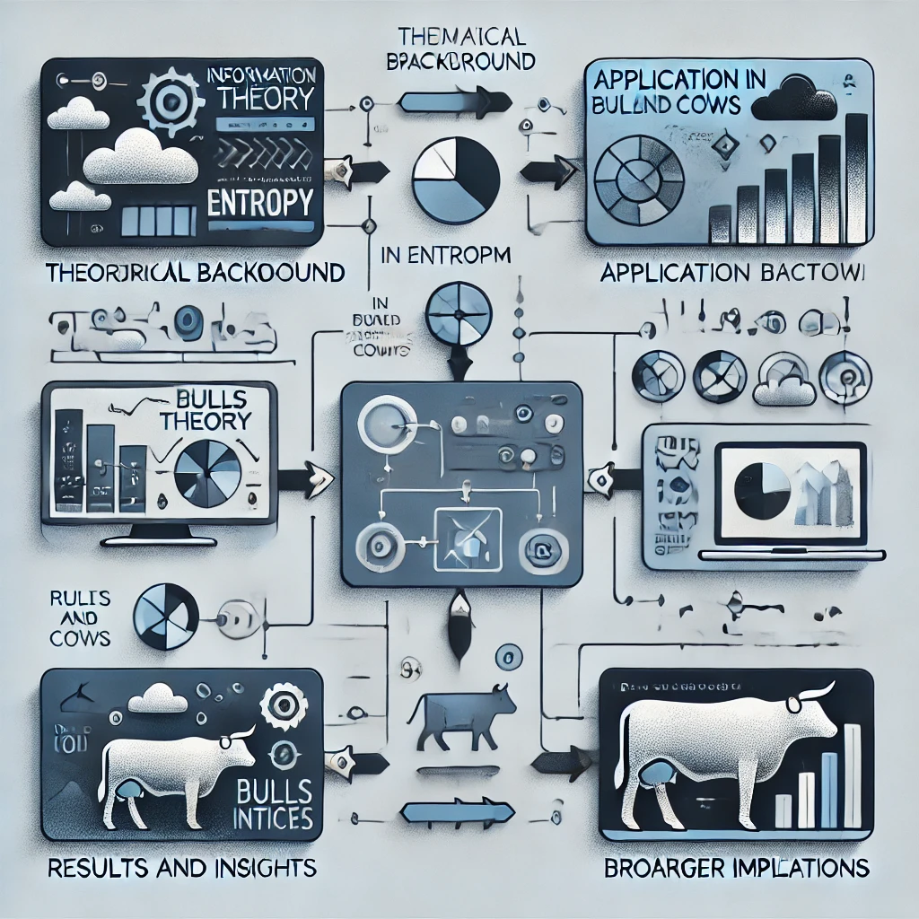
Overview of the Presentation
We’ll first dive into the theory behind entropy, then move on to how it applies to the game, followed by an analysis of results, and end with its broader significance beyond games.

Slide 3
Overview of the Presentation

Slide 4
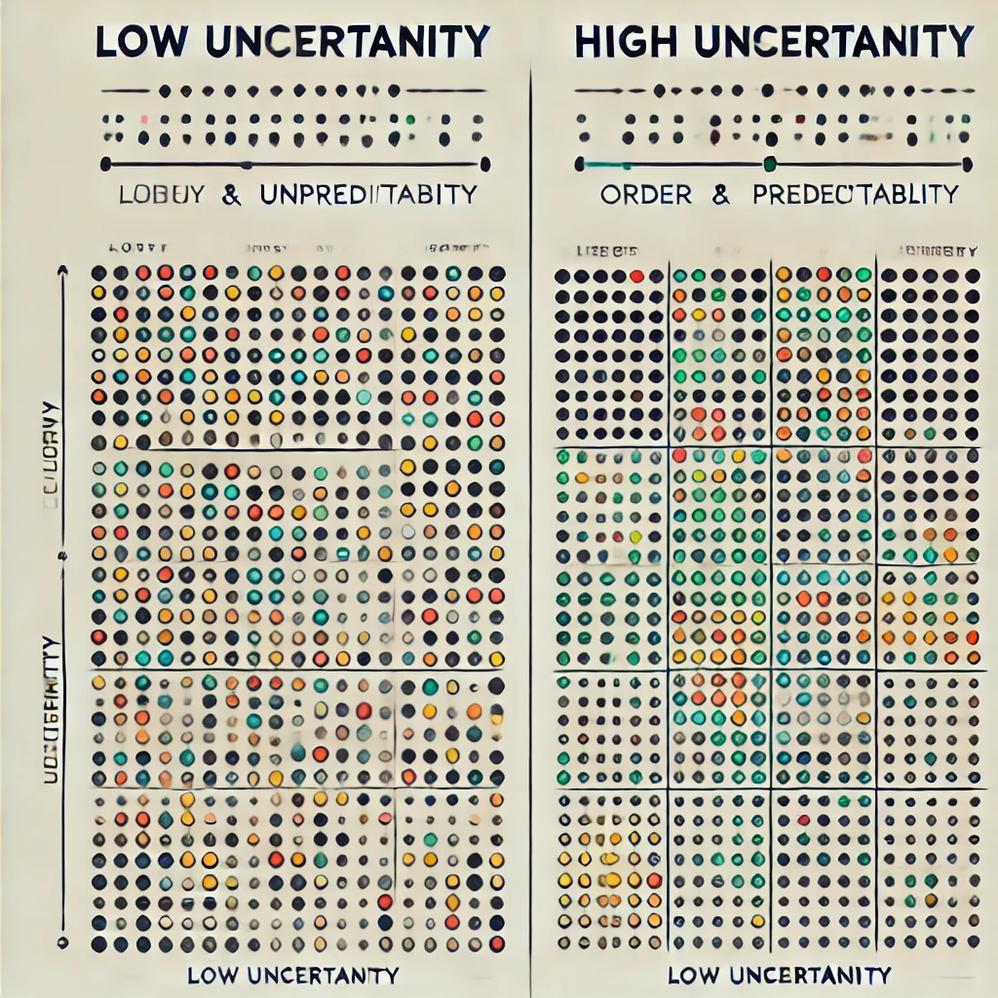
Theoretical Background: What is Entropy?
Higher entropy=greater uncertainty
Low uncertainty = Predictable, fewer possible outcomes
"Entropy measures uncertainty or randomness in a system."
Introduced by Claude Shannon in 1948 as part of information theory.
Examples:
Fair coin flip: High entropy due to equal uncertainty.
Biased coin: Zero entropy as the outcome is predictable.

Slide 5
How Feedback Reduces Possibilities
What is Entropy?
Entropy measures uncertainty or randomness in a system
Application in Bulls and Cows:
Feedback(Bulls and Cows) reduces entropy
Less entropy = Fewer possibilities remain
Goal:
Minimize entropy to find the secret number
Step | Feedback | Entropy(Bits)
Initial Guess | - | 4.0
After First Guess | Bulls=1, Cows=2 | 3.0
After Second Guess | Bulls=2, Cows=1 | 1.5

Slide 6
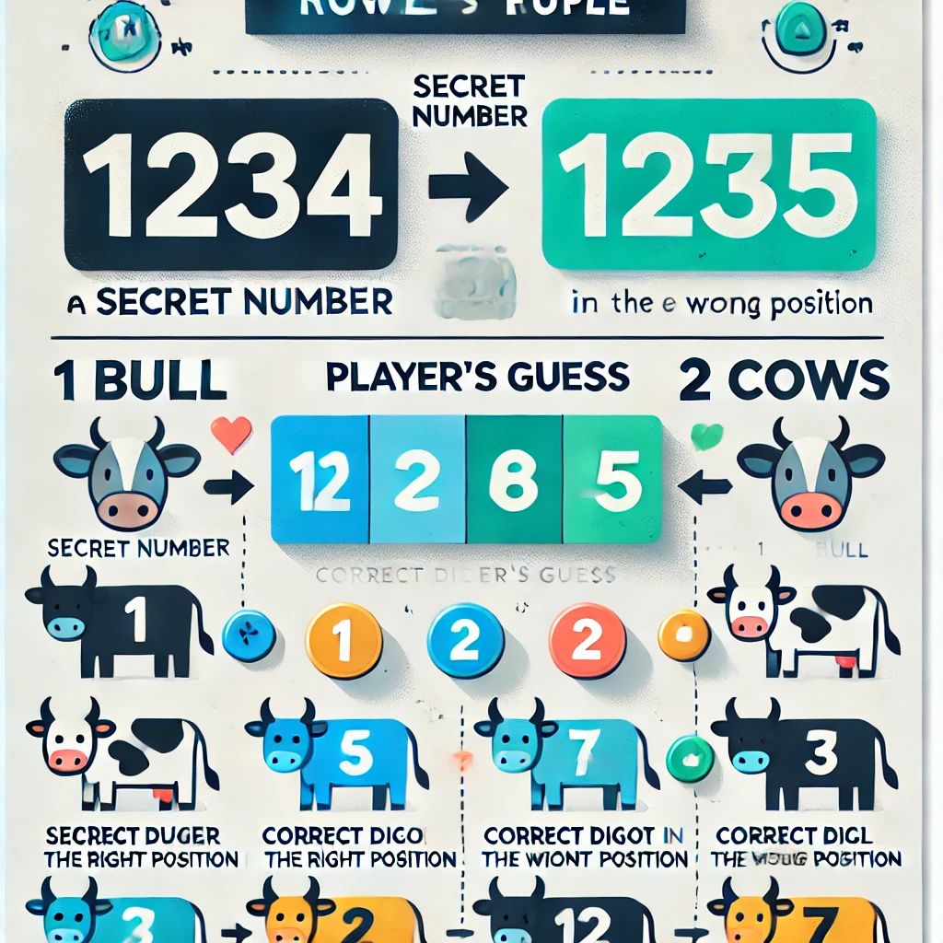
Game Mechanics
Rules of Bulls and Cows
In 'Bulls and Cows,' the goal is to guess a secret 4-digit number. For every guess, we receive feedback in terms of bulls—digits in the correct position—and cows—correct digits in the wrong position
The challenge lies in using this feedback to systematically reduce the number of possible numbers.

Slide 7
Steps in Bulls and Cows Using Entropy
Step 1 Initial Guess
Step 2 Feedback(Bulls and Cows)
Player Receives feedback (e.g., Bulls=1, Cows=2)
Step 3 Narrow Down Options
Based on feedback, eliminate invalid combinations
Step 4 Final Guess
When only one combination remains, entropy is zero
All combinations are possible
Entropy is at its maximum, as there’s the most uncertainity
Feedback reduces the number of possible solutions
Reduced possibilities mean lower entropy
The correct answer is identified

Slide 8



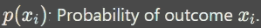
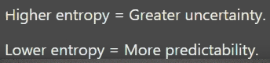
Shannon’s Entropy Formula

Slide 9
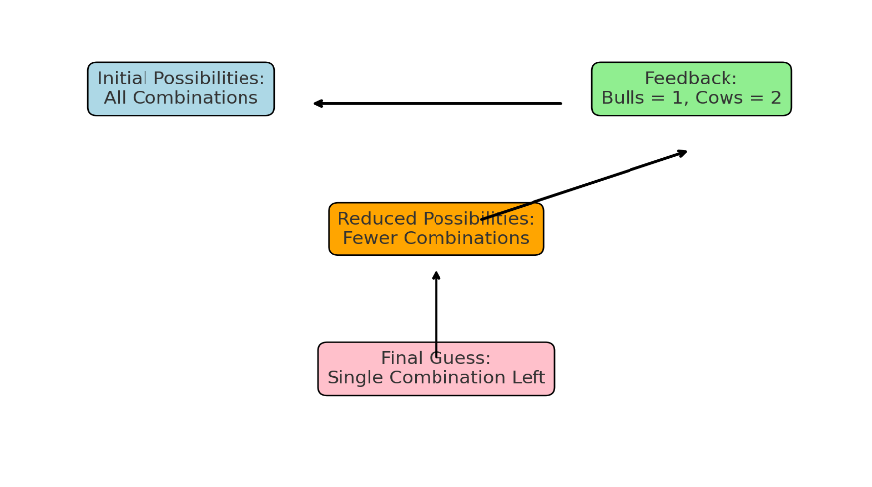
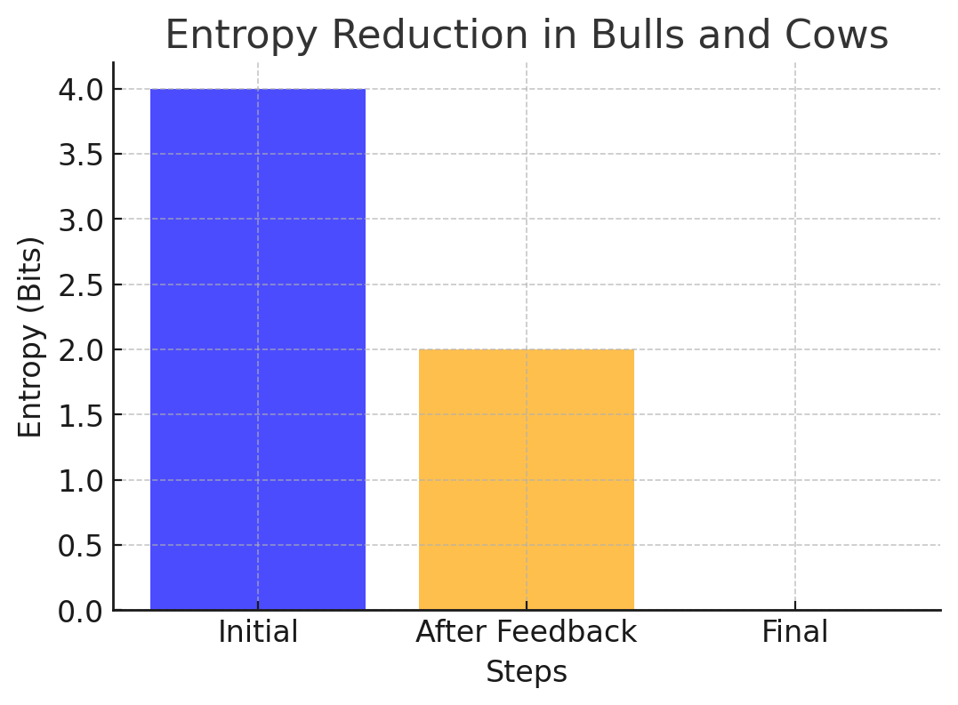
Entropy in Bulls and Cows
Key Points
Bulls: Correct digits in the correct positions.
Cows: Correct digits in the wrong positions.
Quantifies uncertainty in remaining guesses after feedback.
Helps measure progress toward guessing the secret number.

Slide 10
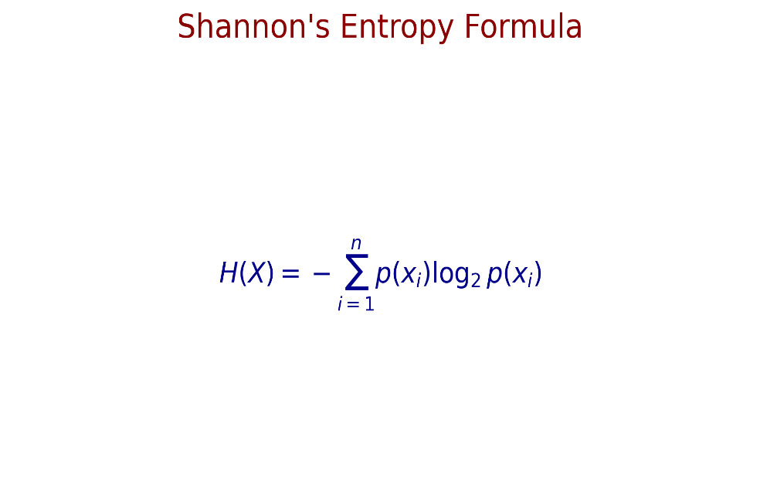
Steps in Entropy Calculation
Let’s calculate entropy after a guess. Suppose the secret number is 1234, and we guess 1243, getting feedback of 2 bulls and 2 cows.
We then consider all numbers consistent with this feedback and calculate the entropy of this subset. Lower entropy means fewer possible numbers remain.
This process of guessing, filtering, and recalculating entropy repeats until the entropy reaches zero, which occurs when only one number—the secret number—remains.

Slide 11
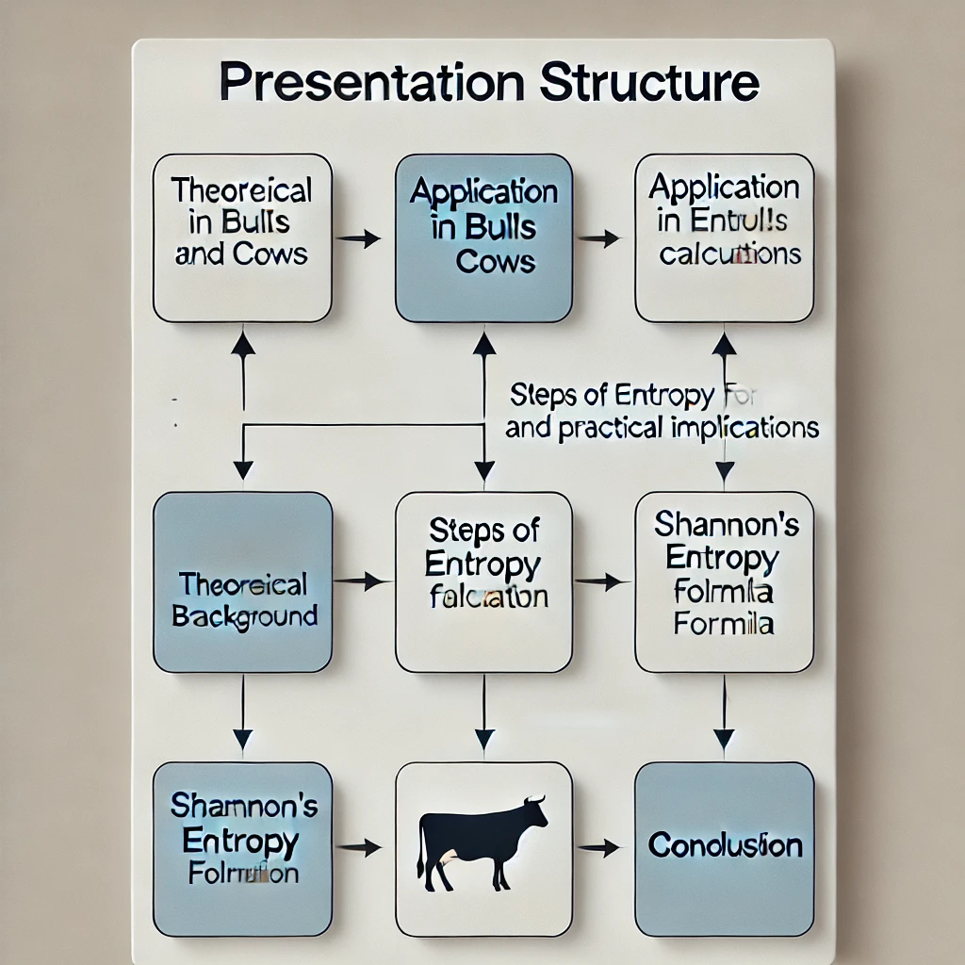

Practical Implications of Entropy (Applications Beyond Games)
Entropy isn’t just useful for games. It’s a fundamental concept in machine learning, data compression, and cryptography
For example, in data compression, entropy helps identify patterns to reduce file sizes. In machine learning, it’s used to calculate information gain in decision trees
Additionally, in cryptography, entropy ensures the strength of encryption keys by maximizing randomness, making systems more secure against attacks.

Slide 12
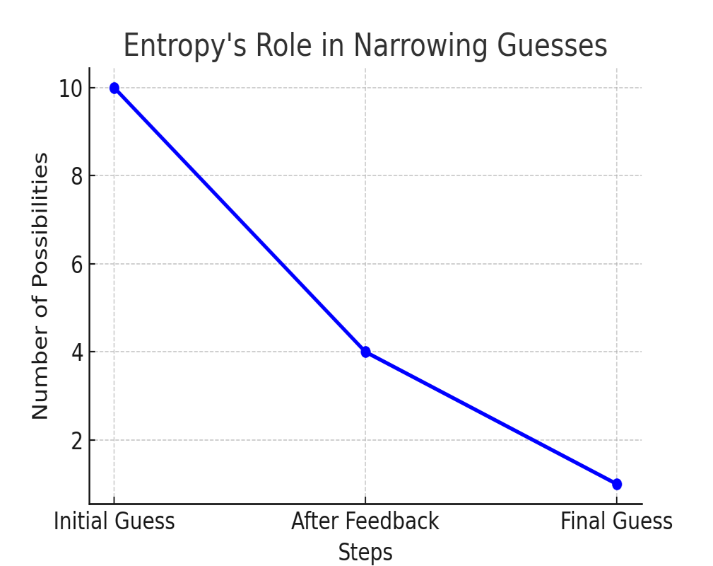
Wrapping up: Why Entropy Matters?
To summarize, entropy measures uncertainty and guides decision-making. In 'Bulls and Cows,' it helps us systematically reduce possibilities to guess the secret number more efficiently.
This approach not only improves game strategies but also highlights the universal importance of theoretical concepts in practical scenarios.

Slide 13
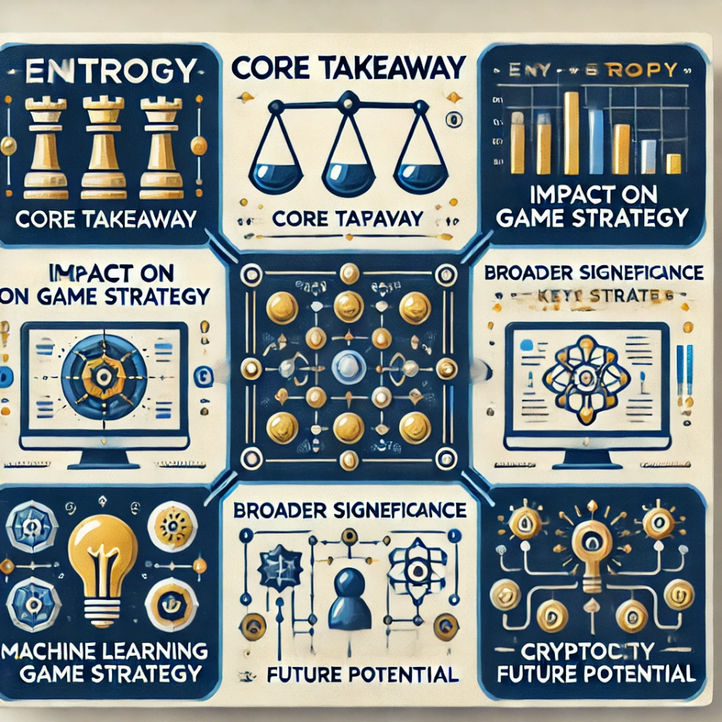
Conclusion
This project underscores the importance of feedback loops in reducing uncertainty, a concept that’s central to many decision-making processes in technology and science.
Exploring entropy further can help innovate in areas like artificial intelligence, where understanding and reducing uncertainty is key to making systems smarter and more adaptable.
Using entropy-based strategies demonstrates how theoretical concepts can directly translate into practical problem-solving, improving both efficiency and accuracy in gameplay

Slide 14


Thank You!
Entropy: From Theory to Practice in Bulls and Cows and Beyond…
Presented by Mihir Bhansali
Project: Understanding Entropy in Bulls and Cows

